Slide 1



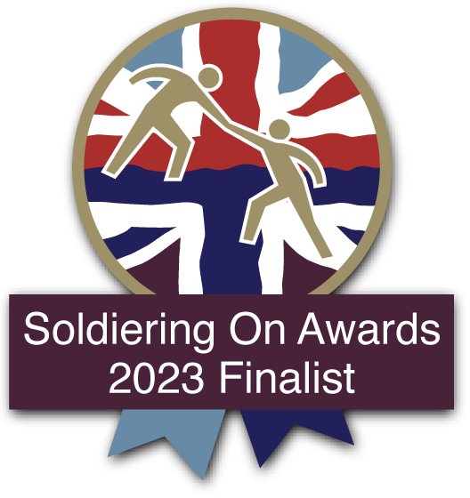


PTSD Resolution:
Transforming the Lives of UK Veterans, Reservists and their Families
WINNER 2023

Slide 2


Who We Are

Slide 3

Who We Are
PTSD Resolution is a leading Armed Forces' charity (no. 1202649) -
providing one-to-one therapy to Veterans, Reservists & families struggling
with trauma & other mental health problems.
We deliver free, prompt, local (to you) & effective therapy
Nearly 5,000 referrals to date, with a nationwide network of 200 therapists
Therapy is available in person and online according to need
'Lean' charity organisation: no salaried staff or assets

Slide 4
Who We Are
We were the first charity to treat Veterans in prison
Cobseo member, the Armed Forces charity organisation
﻿﻿ Accredited by the Royal College of Psychiatrists’ Quality Network for
Veterans’ Mental Health Services
An average of only seven sessions is required to complete a programme
Cost-effective - average cost of the treatment is £940 per programme
No referral required, no waiting list
First appointment within 2 weeks

Slide 5
Our Charitable Mission
The relief of the mental sickness of Veterans of the Armed Forces,
and their families, with post-traumatic symptoms
Research into the treatment of PTSD
Educating Veterans and the public about PTSD
Promoting social inclusion of Veterans in the justice system
Provide training and support to therapists dealing with trauma
from foreign war zones

Slide 6

Why We Are Needed

Slide 7

Why We Are Needed
253 UK Armed Forces Veterans took their own lives in 2021
The MOD has recorded a 31% increase in PTSD cases over the last 13 years *
1 in 8 (13.2%) UK Armed Forces personnel were seen by military
healthcare services for a mental health related reason in 2022/23 **
Suicide rates are 2-4 times higher for Veterans under the age of 25,
when compared with the general population of the same age group **
PTSD is not going away - our work is vital
* UK Defence Journal, March 2024
** UK Armed Forces Mental Health: Annual Summary & Trends Over Time, 2007/08 to 2022/23, 29th June 2023 - MOD
*** University of Manchester, December 2022

Slide 8
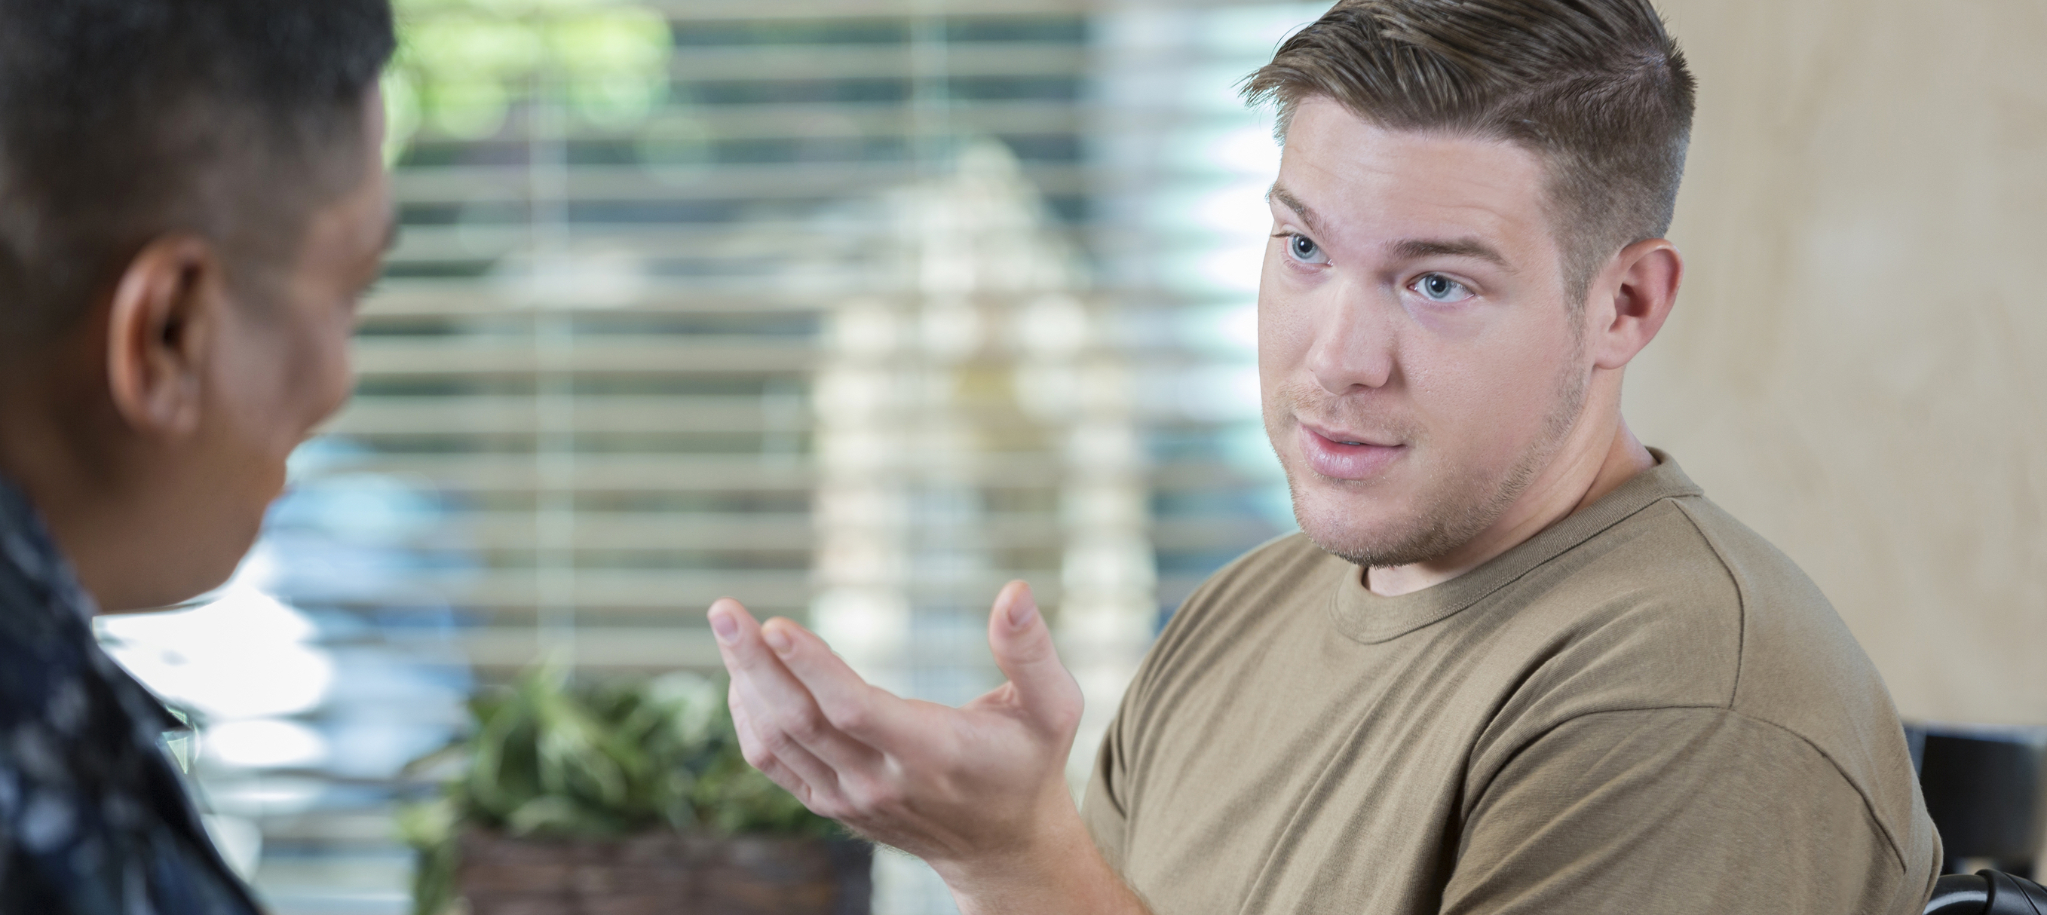
Our Services

Slide 9

Our Therapy
Military life requires training to survive: For Veterans,
we provide mental health training through therapy
﻿﻿No re-living or re-telling of the trauma
﻿﻿Therapy takes an average of seven, one-hour sessions
Treatment is confidential, non-intrusive and non-invasive
66% of those who stay in therapy reliably recover
82% of beneficiaries who start therapy remain in treatment to
an agreed planned ending
We have treated beneficiaries within the prison service for over ten years

Slide 10
Our Therapy
FREE - Our therapy is free for Forces’ Veterans, Reservists and their families.
PROMPT - The beneficiary will usually see an appointed therapist within two weeks
of deciding to proceed with therapy. There is no waiting list.
EFFECTIVE - Our therapy is proven to be highly effective with most beneficiaries
showing significant improvement.
LOCAL & ONLINE - With the network of 200 Human Givens therapists across the UK,
the beneficiary is able to see a therapist nearby, or online if they wish.
BRIEF - The beneficiary is treated within an average of seven sessions.
More sessions are available if necessary.
PRAGMATIC - Substance abuse can be a refuge from pain. We believe we are
the only charity which will treat beneficiaries with this issue, providing
they are sober at the time of treatment provided.

Slide 11
What Is Human Givens Therapy?
The PTSD Resolution therapist network are all Human Givens therapists who have successfully passed the Human Givens Diploma at practitioner level (HG.Dip.P.). They are therefore trained in dealing effectively, and as quickly as possible, with all major forms of mental distress – including post-traumatic stress disorder (PTSD).
Delivered exclusively by 200 therapists UK- wide exclusively registered with
the Human Givens Institute, accredited by the Professional Standards Authority﻿﻿
Clinically measured improvement of conditions﻿﻿
Modern, using latest research
﻿﻿Consistent with NICE guidelines

Slide 12
Social Support
Since 2015, PTSD Resolution has provided social support to beneficiaries post- therapy, addressing practical needs.
We provide social support and advice on:
Housing
Household items
Debt issues
Legal problems
Social support and engagement
Hobbies and recreation
Application form filling for benefits and other support
Computer laptops

Slide 13

Our Impact Over the Last Decade

Slide 14

Our Impact Over the Last Decade
We treated 4,027 beneficiaries
We raised over £2.48 million
Over the last 10 years 85.76% of costs has been spent on charitable objects
92% of donations go directly to pay for charitable objects
Current cost per beneficiary is £940

Slide 15
Beneficiaries’ Testimonials
AB, Service in Afghanistan
“My treatment has really calmed me down and I can talk about my job and active duty
without freaking out. Even the creaks in my old house don’t bother me anymore!
My family have noticed a big difference too: I no longer detonate over nothing and
we’re all getting on so much better.”
JF, Service in Bosnia, Kosovo, Iraq and Afghanistan
“I finished each of the sessions feeling better than when I started. So far, I’ve not had
a single flashback nor have I had any problems with anxiety or sleeplessness. Even better,
I have a range of skills to help me cope with anxiety, depression and any stressful
situations which I might encounter in the future.”

Slide 16
Beneficiaries’ Testimonials
SP, Partner of a Veteran
“In January 2015, my husband attempted suicide after receiving a diagnosis of PTSD and
our marriage subsequently broke down. Our PTSD Resolution sessions have made the
traumatic memories fade more quickly and feel less significant. I really feel positive about
the road ahead and my marriage is back on track.”
CL, Service in Afghanistan
“I used to spend all my time in bed or in my shed, hiding away from people, but I’m now
planning on going travelling - that’s how much things have changed. At first, I thought
this treatment was a ‘fluke’ but now I realise that it really does work and things just keep
getting better and better!”

Slide 17
Beneficiaries’ Testimonials
DT, Service in Falklands
“Without question, I would recommend this treatment to others. I found the service
provided by PTSD Resolution to be non-threatening, welcoming, open and comforting.”
RJ, Royal Air Force
“PTSD Resolution cured me on day one! I relaxed immediately and my therapist gave me
the confidence to talk about the events which had traumatised me. I feel so much better
- I’m sleeping properly, I’m relaxed around others, and I have more confidence. I would
highly recommend them to others and I already have - to around 30 people!”
More statements can be found on our website:
www.ptsdresolution.org/testimonials.php

Slide 18

Education and Training

Slide 19

Trauma Awareness Training for Everyone
(TATE)
We provide bespoke training solutions for individuals and organisations. Training is currently delivered online, using a video conferencing platform such as Zoom, meaning that employees working from home can easily attend.
Our TATE sessions vary in length, from a two-hour interactive presentation through to a full day of teaching and activity, and are designed to introduce staff, line managers and senior management
to key understandings about trauma.

Slide 20
Trauma Awareness Training for Everyone
(TATE)
A TATE course enables attendees to:
Recognise post-traumatic symptoms
Understand the effects of trauma on human behaviour
Engage with traumatised people to explore practical options
Identify clear routes to resolving workplace difficulties caused by trauma

Slide 21
Trauma Awareness Training for Everyone
(TATE)
Feedback we have received:
“The best day’s training I have ever attended. Period.”
- Specialist Paramedic
“Makes very complex issues easily understandable and I am taking away far more than I expected from today. I know what signs to look out for now and I’ll feel much more confident dealing with students who are distressed.”
- University Welfare Officer
“I recognised my husband in so many of the slides that were shown today. Now I know what’s going on I can try to encourage him to get help and know where to turn to get it.”
- HR Manager and Veteran’s Wife

Slide 22
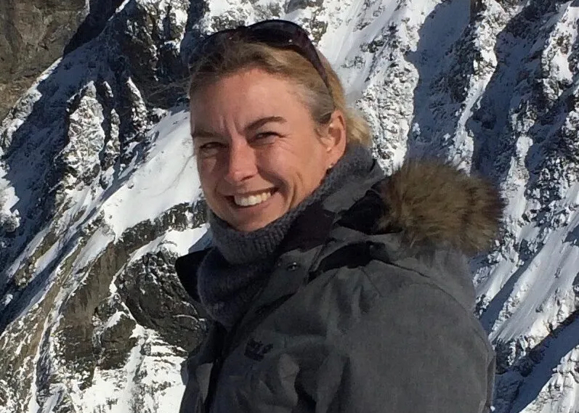
Trauma Awareness Training for Everyone
(TATE)
What NHS delegates say:
“Excellent training, very well delivered with a balance of activities to support learning. Clear and well explained.”
“Best training that I have done in a long time.”
Rosalind Townsend
TATE Course Leader and PTSD Resolution Trustee

Slide 23

Financial Stewardship

Slide 24

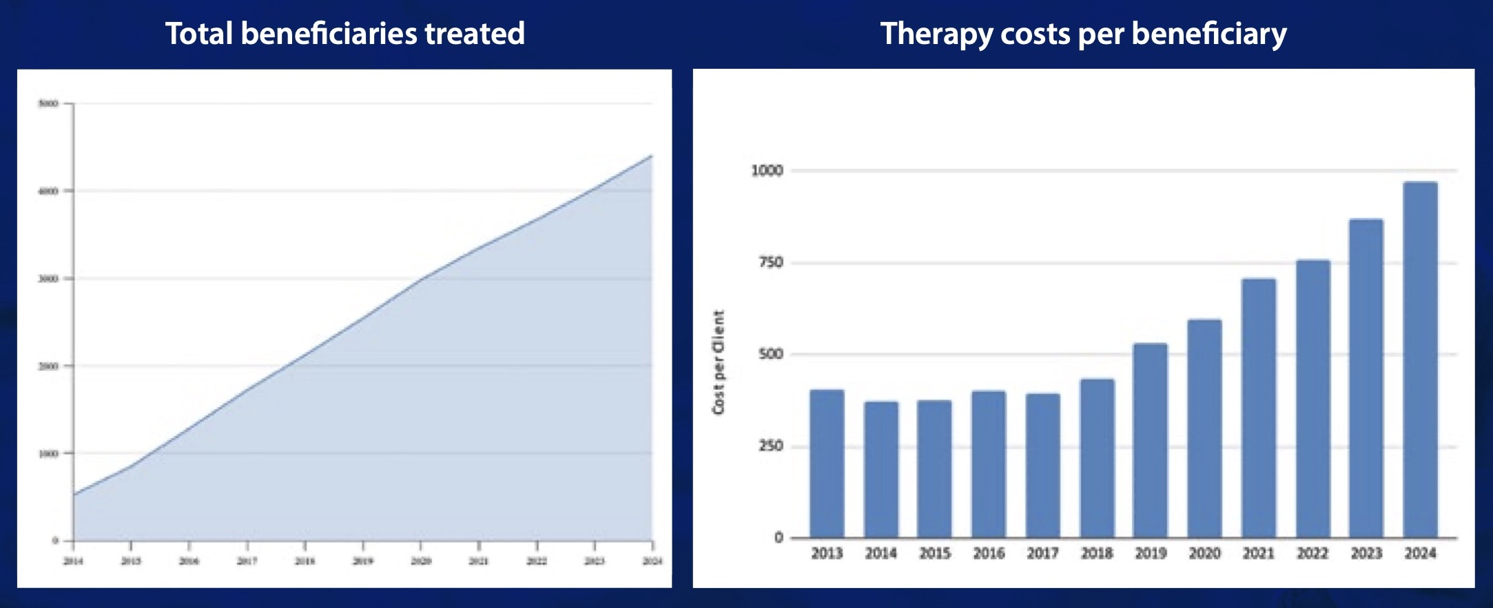
Financials 2024
In the financial year ending 30th April 2024, PTSD Resolution spent
£369,500 helping our beneficiaries. We treated 460 beneficiaries,
making the total treated since the start of the charity 4,407.

Slide 25
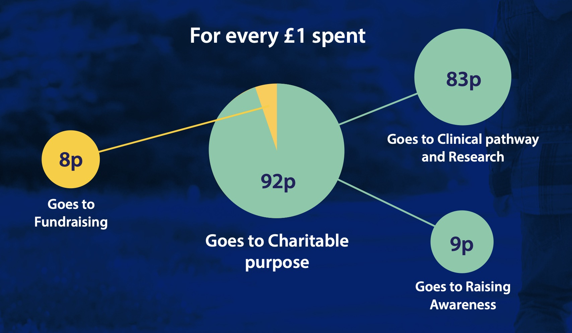
Financials 2024: Breaking it down

Slide 26
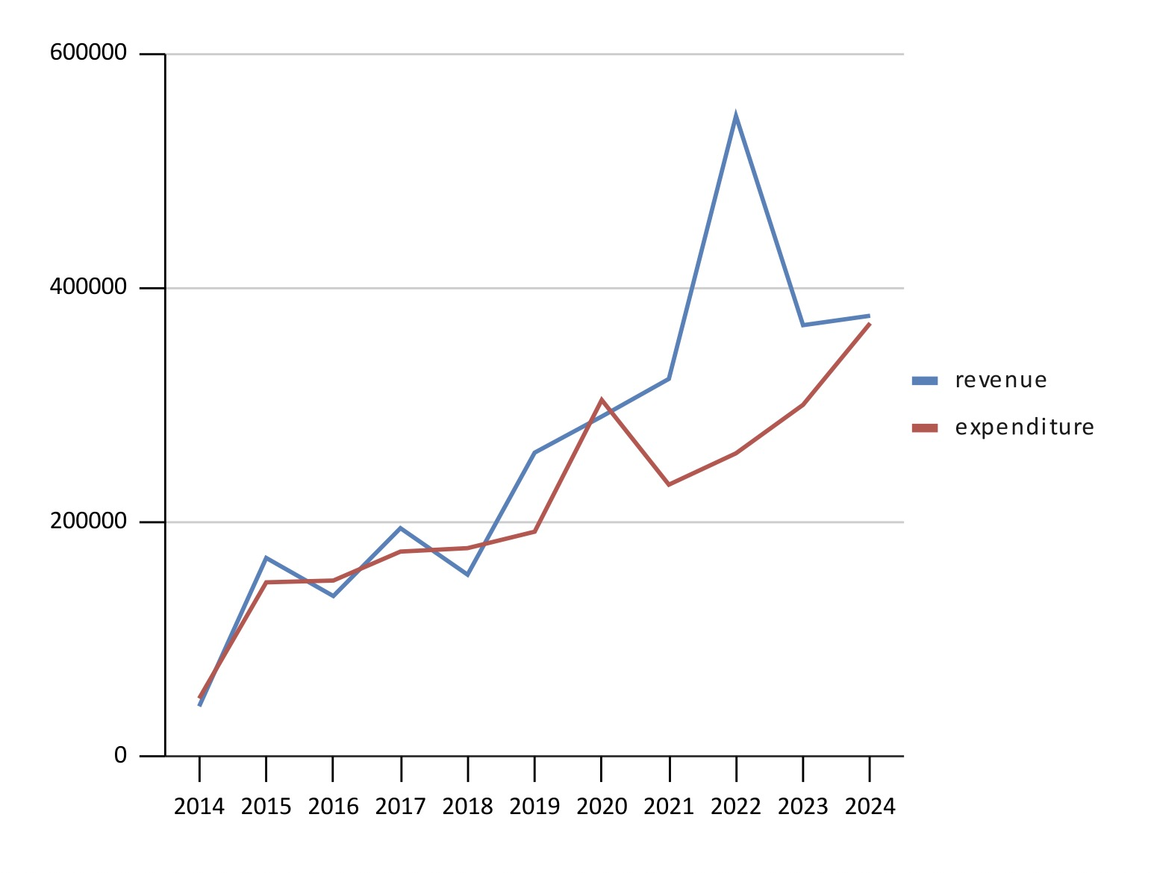
Financials 2024: Breaking it down
Over the last 10 years
our income has kept up with
the demand for our services.

Slide 27

How You Can Support Us

Slide 28

How You Can Support Us
Your donation or fundraising will help meet the cost of treatment
for Veterans, Reservists and families. A course of therapy costs the charity an average of £940, delivered free of charge to the beneficiary.
Donate securely through our website @ www.ptsdresolution.org/donate
﻿﻿Fundraise - at home, at work or form a fundraising group
﻿﻿Buy the latest book on PTSD - £10 from Amazon
Spread the word! Help signpost through your social media & local contacts
﻿﻿Sign up to our newsletter

Slide 29
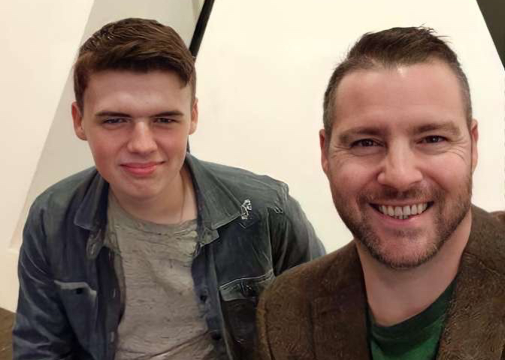
Star Fundraiser: Oliver Hopkins
When Oliver Hopkins lost his father to PTSD in 2018, he put out a call to “raise money
to stop this silent killer.” Oliver initially aimed to raise just £3,500 - but his honesty, eloquence
and love for his dad struck a chord and he has raised over £15,000.
“My dad had been in the 9/12th Lancer regiment since he was 16 years old... He loved his job, but behind the smiles he was carrying a burden of the sights he had seen and the events he witnessed, and became very unwell, suffering with PTSD, and we lost him on Christmas Eve 2018.
“I do not want my dad’s death to be in vain, nor do I want
the bad to be remembered. Only the positive. My dad was
a good man who affected everyone he met in a positive way.”
Oliver Hopkins has raised £15,686

Slide 30
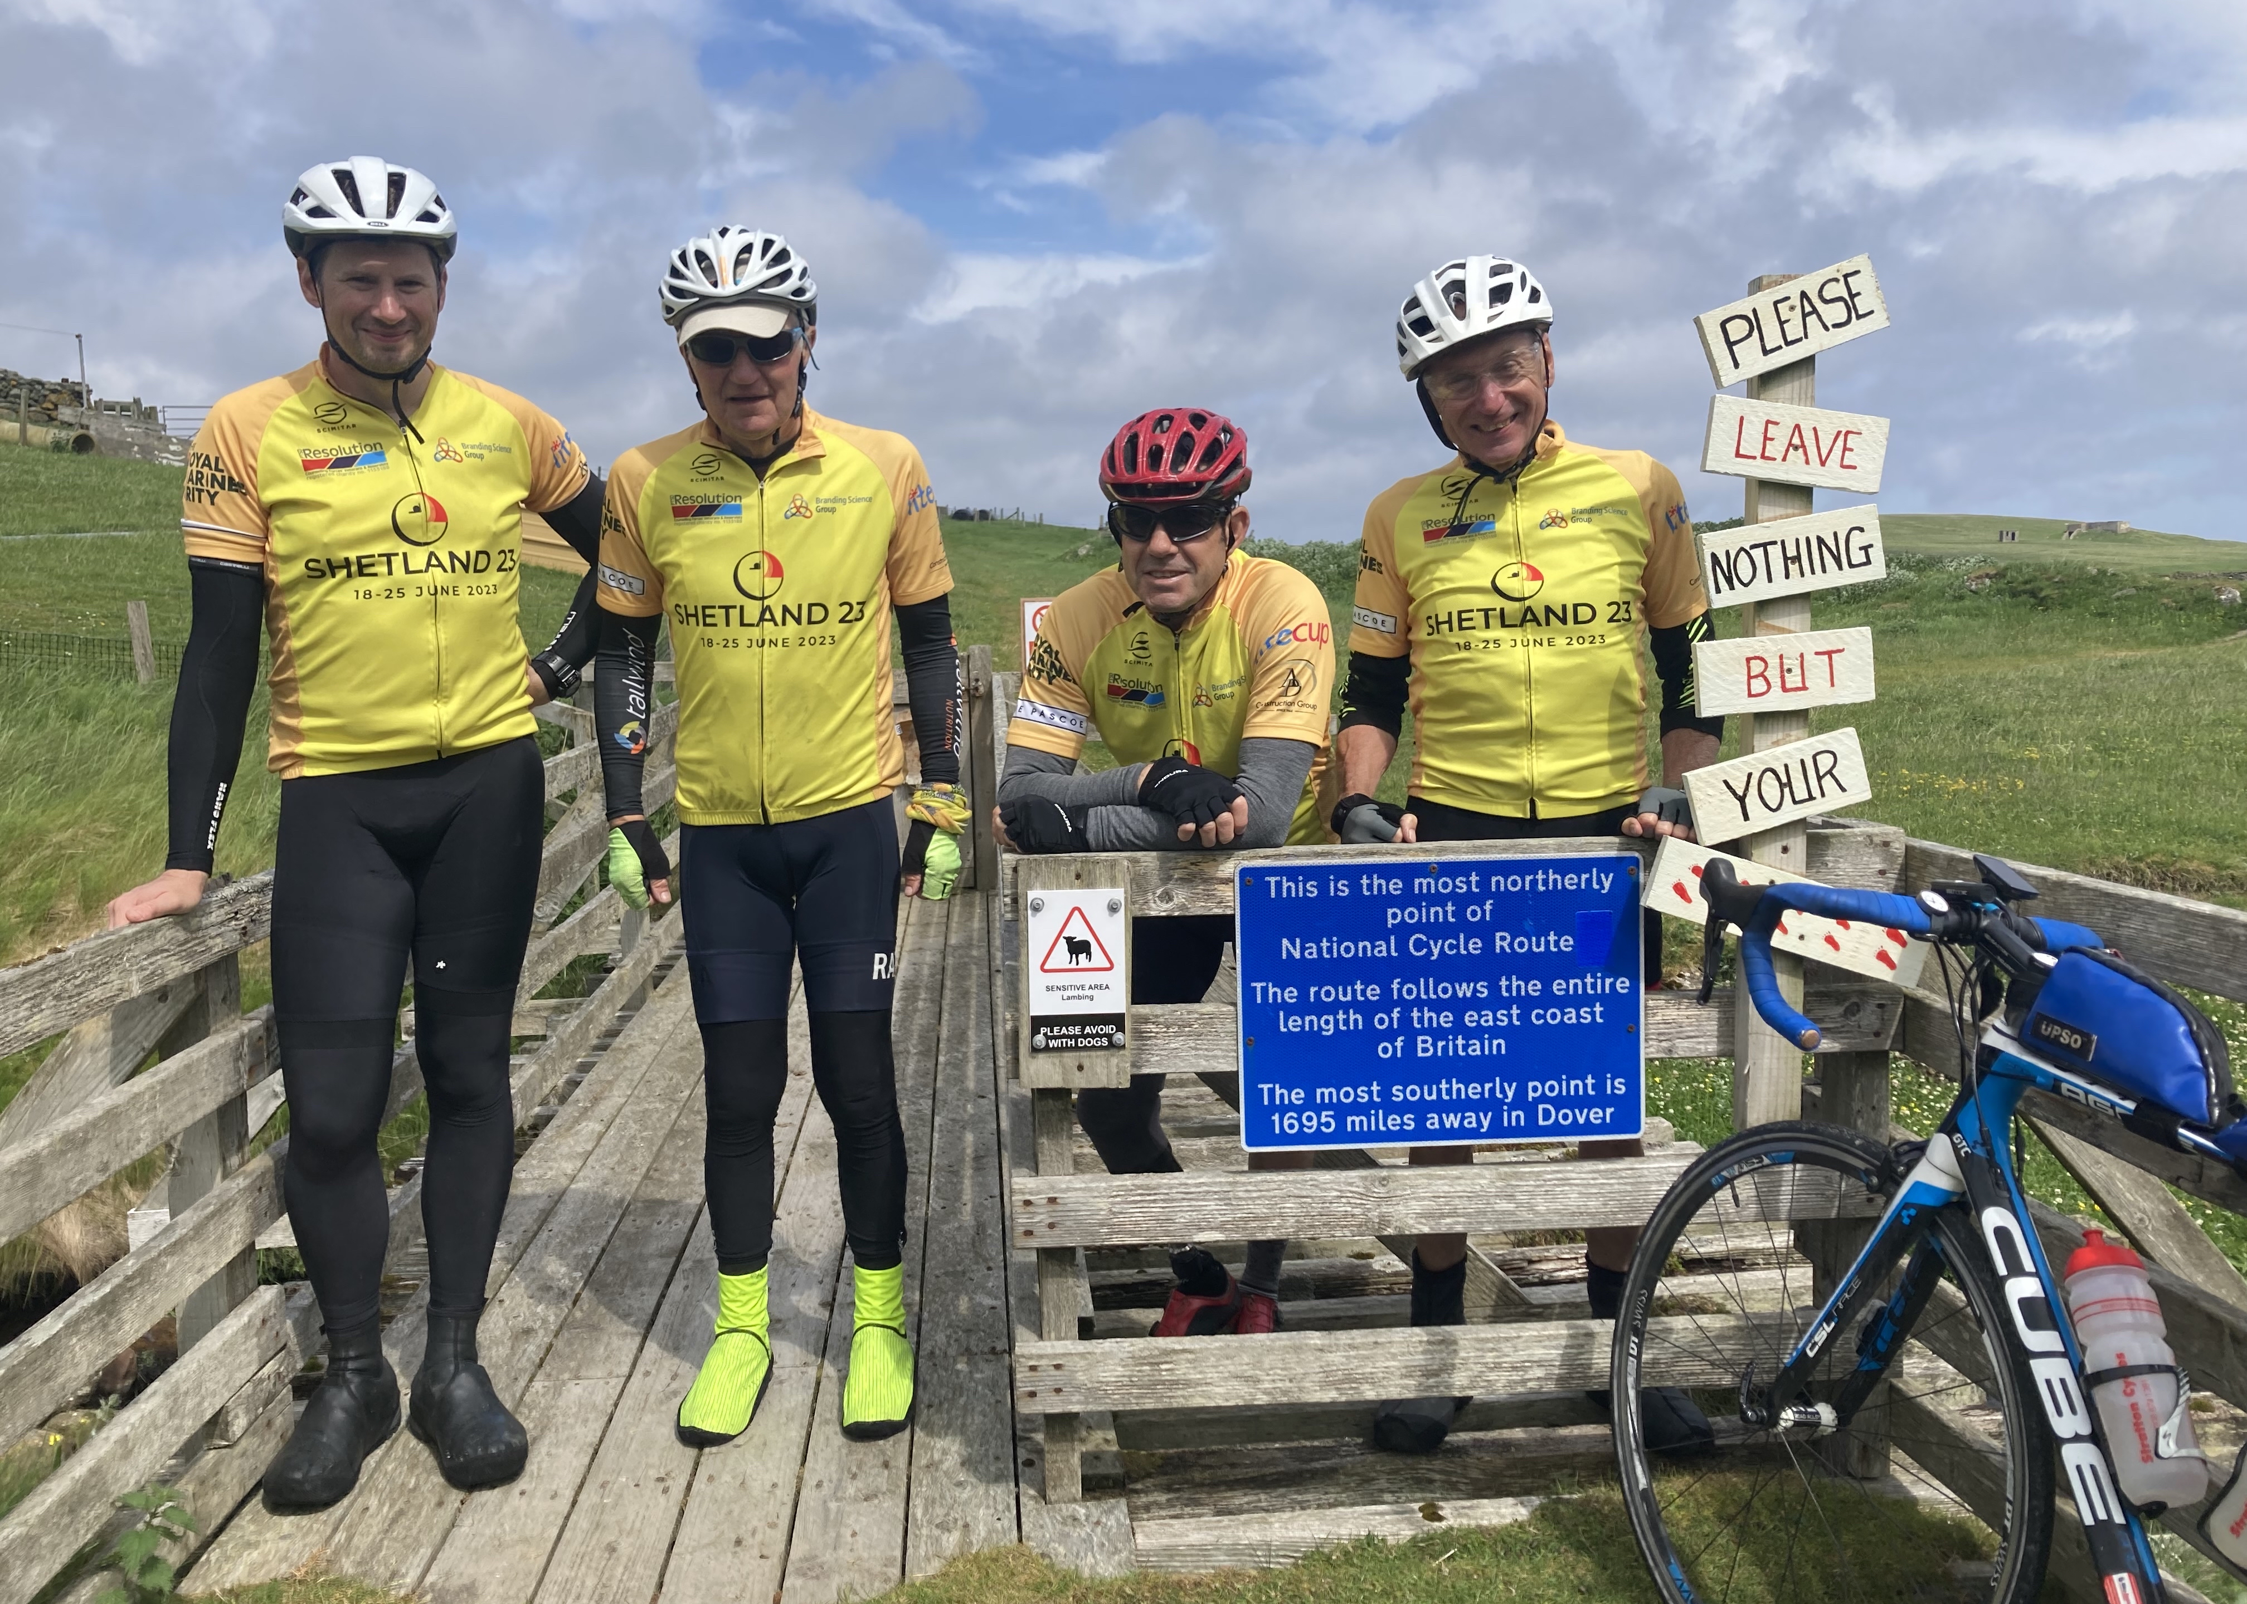
Star Fundraiser: Jonathan Thomson
Jonathan Thomson, a 77-year-old former Royal Marine, has raised over £158,000 for PTSD Resolution and UK forces beneficiaries - with a series of impressive cycling challenges. His endeavours have included a journey along Scotland’s north coast in 2020, a gruelling ride through the French Pyrenees in 2021 and ‘Cycle Wales’ in 2022.
In June 2023, Jonathan and his team set off from Northern Scotland on a dramatic 7-day, 750 km bike ride around the Orkney and Shetland islands. This was Jonathan’s fourth cycle ride for PTSD Resolution.
- All expedition costs are met privately so all funds raised
go directly to PTSD Resolution.
Jonathan Thomson has raised over £158,000

Slide 31

Companies & The Public Sector
Organisations that support PTSD Resolution can protect the mental welfare of staff and meet their CSR commitments under the Armed Forces Covenant (AFC). Some have gone on to win gold awards under the Defence Employer Recognition Scheme (ERS).
Sponsor a beneficiary
Donate
Staff payroll giving
‘Charity of The Year’ - our guest speakers at your events
“I would highly recommend PTSD Resolution to any employer who wishes to provide the best possible care to their ex-service personnel. It is instrumental in ensuring the wellbeing of our Ex-Forces community.”
- Stewart Sharman, Deputy MD (UK) & Head Ex-Forces Programme at FDM Group

Slide 32





Help Us Help Them
Every donation makes a difference.
Your support can transform lives - by helping our Veterans
and their families overcome the challenges of trauma.
Contact PTSD Resolution on:
0300 302 0551
contact@ptsdresolution.org
www.ptsdresolution.org
@ptsdresolutionUK
@ptsdresolution
@ptsdresolution
@PTSD Resolution

Slide 33
In Summary
Free help for Veterans, Reservists and families suffering from mental health issues
Confidential treatment. No referral required.
﻿﻿Local help through Accredited Therapists with online/phone therapy available
﻿﻿Fast treatment, issues usually resolved in an average of seven sessions
﻿﻿First appointment with therapist on average 12 days from registration of beneficiary
﻿﻿Compassionate: no need for clients to talk about events in their past
﻿﻿Cost-effective, £940 per programme
﻿﻿Transparent, results are collated and reported
﻿﻿Cobseo member, the Armed Forces charity organisation
﻿﻿Accredited by the Royal College of Psychiatrists’ Quality Network for Veterans’ Mental Health Services
Thank you for your time and consideration.

